Slide 1

Recruitment Management System: Streamlining the Hiring Process
This presentation outlines the backend architecture and key features of a comprehensive recruitment management system designed to simplify and expedite the hiring process.

Slide 2
Job Posting and Management
Postings
Distribution
The system allows for easy creation and management of job postings, including the ability to customize job descriptions, specify qualifications, and set application deadlines.
Postings can be distributed across multiple job boards and social media platforms, expanding the reach to a wider pool of potential candidates.

Slide 3

Applicant Tracking and Screening
Application Intake
Initial Screening
The system tracks all applications received, storing applicant information, resumes, and cover letters in a centralized repository.
Automated screening filters based on keywords and predefined criteria help identify qualified candidates for further review.

Slide 4
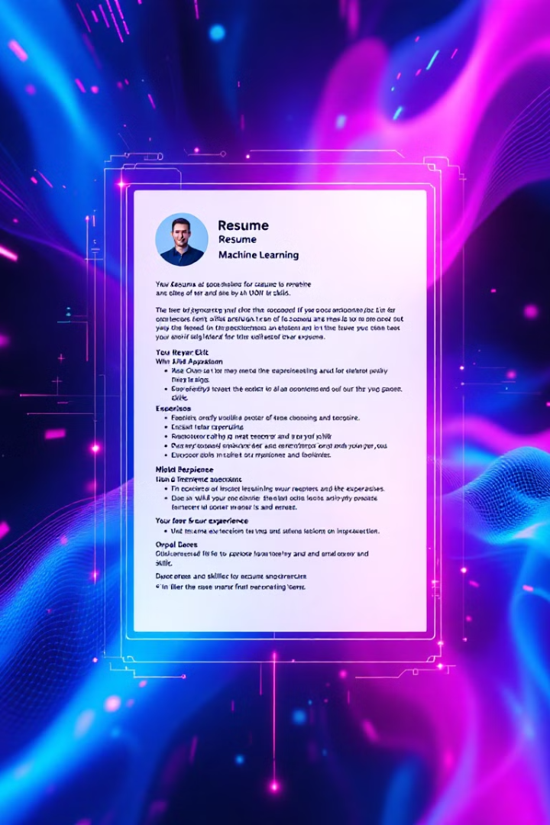


Automated Resume Parsing
AI-Powered
Data Extraction
The system leverages AI-powered resume parsing technology to extract key information from applicant resumes, streamlining the screening process.
Extracted data, such as skills, experience, and education, is automatically added to the applicant database, making it easy to compare candidates.

Slide 5
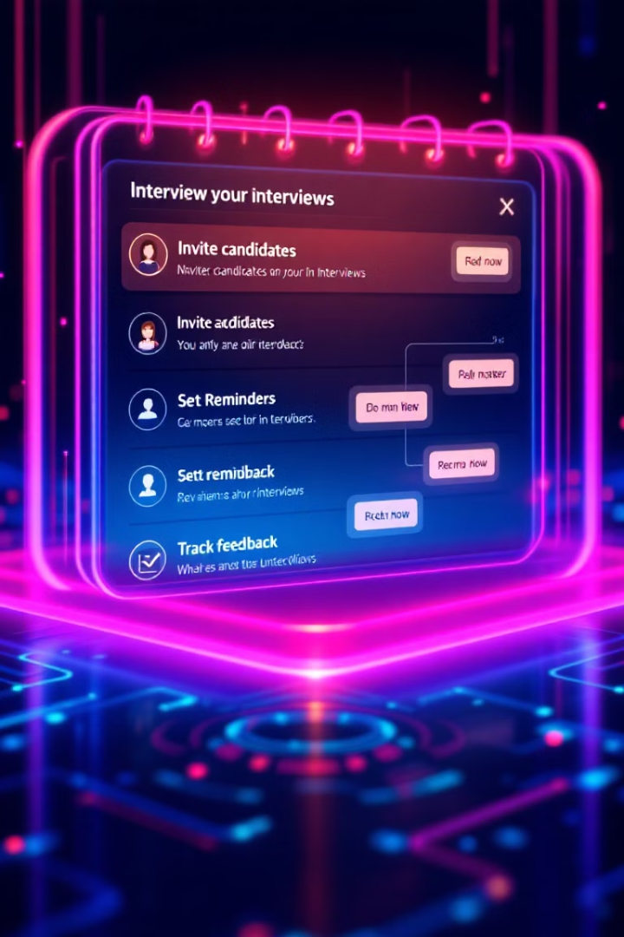
Interview Scheduling and Management
1
Scheduling
The system enables efficient scheduling of interviews, allowing recruiters to manage interview slots and send automated invitations to candidates.
2
Reminders
Automated reminders ensure that both candidates and interviewers are notified about upcoming interviews, reducing missed appointments.
3
Feedback
A centralized platform for collecting and organizing interview feedback from interviewers helps streamline the evaluation process.

Slide 6



Feedback and Evaluation Tracking
1
Interviewer Feedback
Automated Scoring
2
The system uses a standardized scoring system to assess candidate performance based on interview feedback, providing objective insights.
Performance Analysis
3
Data on candidate performance is collected and analyzed, allowing for ongoing improvement of the recruitment process.

Slide 7

Reporting and Analytics
100%
90%
Data Visibility
Performance Monitoring
The system provides comprehensive reports and analytics, giving recruitment teams access to real-time data on the hiring process.
Key metrics, such as time to hire, candidate conversion rates, and source of candidates, can be tracked and analyzed to identify areas for improvement.

Slide 8



Integration with HRIS and ATS
HRIS
Integration with HRIS systems ensures seamless data flow between the recruitment system and employee records, eliminating manual data entry.
ATS
Integration with existing applicant tracking systems streamlines the process of managing candidates and their profiles, ensuring data consistency.

Slide 9

Conclusion and Next Steps
This recruitment management system provides a comprehensive solution to streamline the hiring process, improve efficiency, and enhance the overall candidate experience. We recommend exploring pilot implementation with key stakeholders to further optimize the system's functionality.

